Slide 1
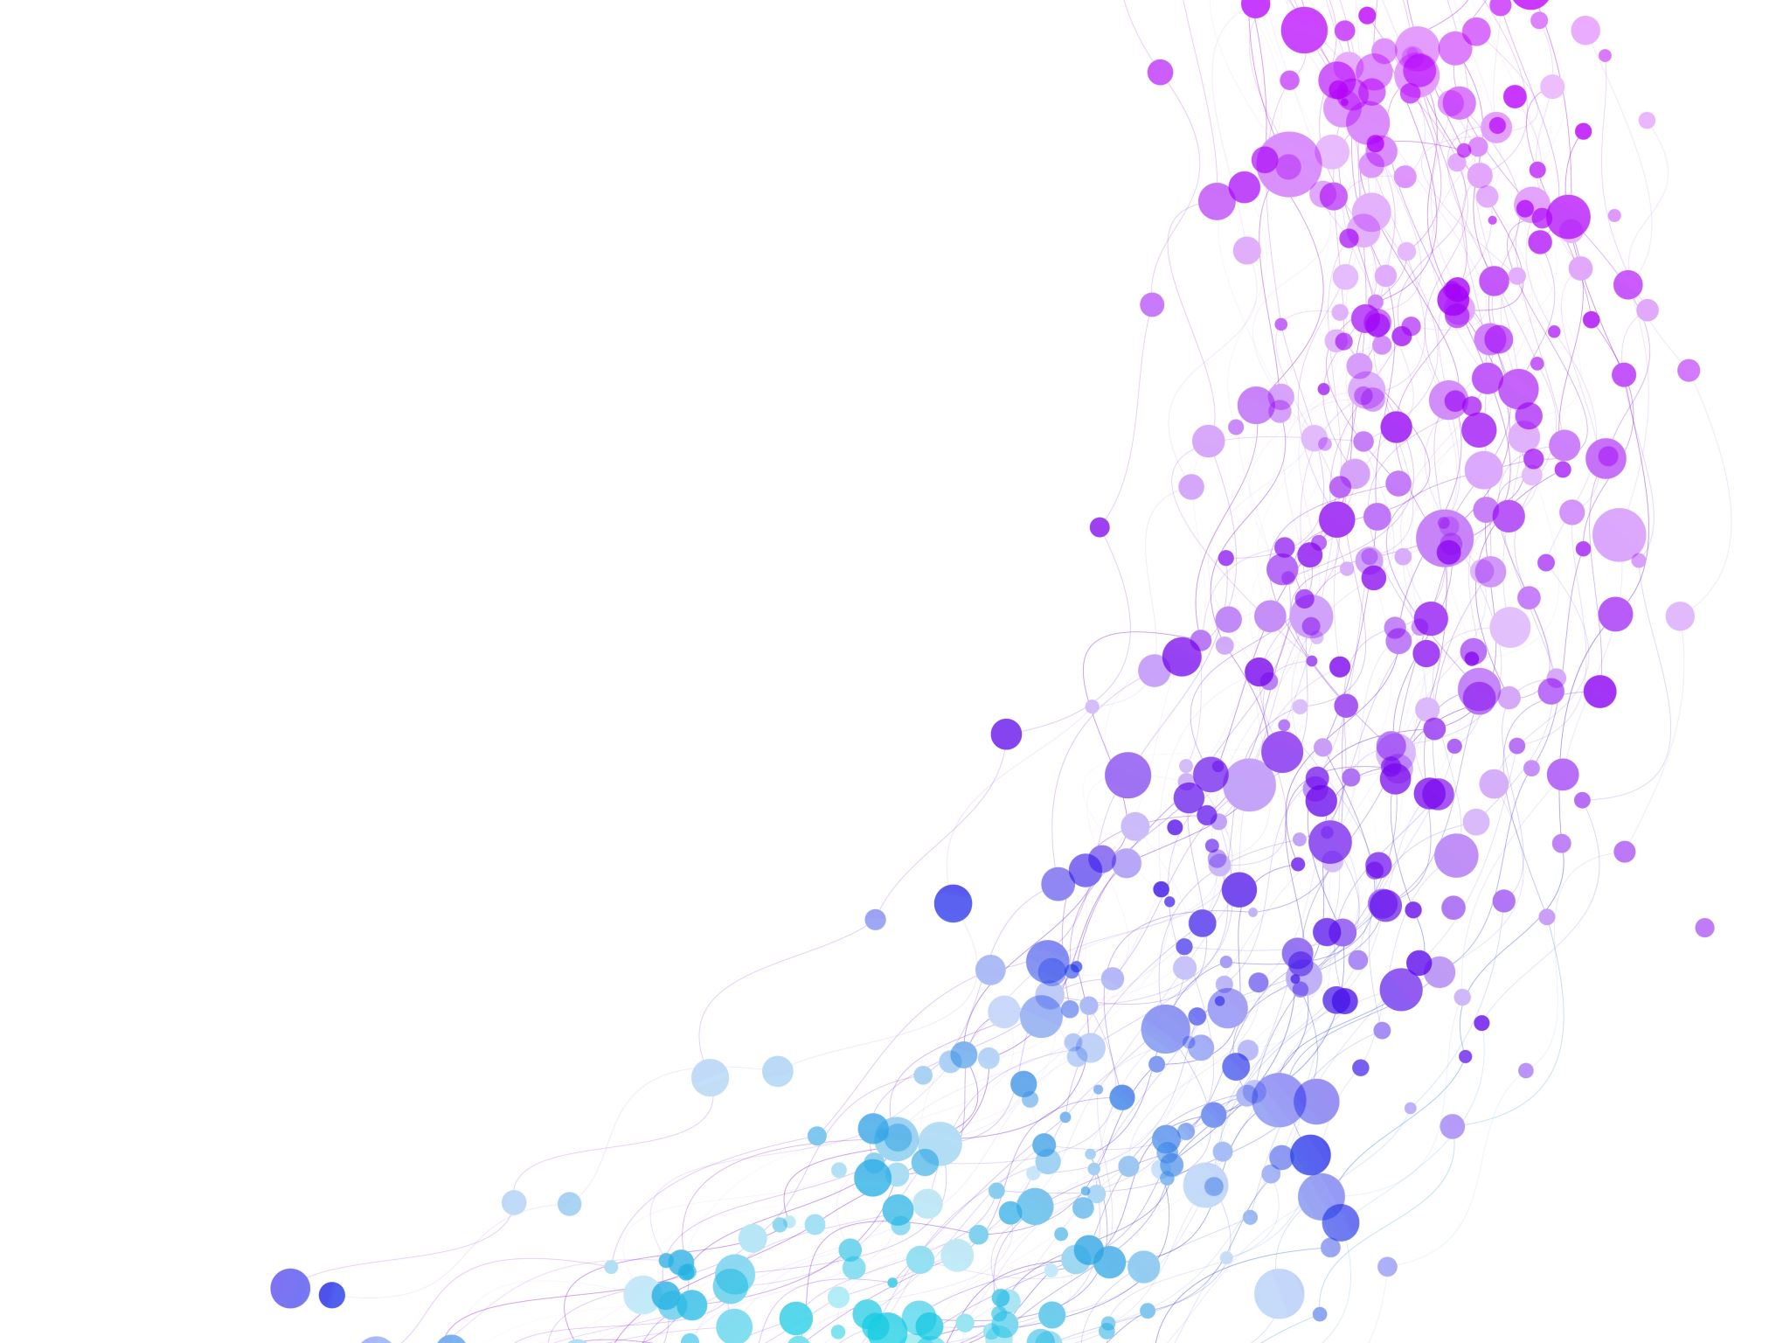


Problem solving using iteration and recursion with examples such as Factorial or Fibonacci numbers Session No.: 10 Course Name: Data Structures Course Code: R1UC308B Instructor Name: Dr. Gaurav Agrawal Duration: 50 mins Date of Conduction of Class:

Slide 2

Review
Pre-Requisite :
Students must have knowledge Recursion and Iteration in C/C++ programming language.

Slide 3

Pre-Class Assessment
[2-mins]

Slide 4

[1-mins]
Both iteration and recursion can be used to repeat a set of instructions. Explain the difference between the two implementations.

Slide 5
Learning Outcomes
[2-mins]
By the end of this session, You will be able to:
Apply iterative and recursive approaches to solve computational problems such as factorial and Fibonacci series.
Analyze and compare the efficiency of iteration and recursion in terms of time and space complexity for given problems.

Slide 6
Session Outline
Introduction to Iteration and Recursion
Solving Factorial with Iteration (Loop-based approach)
Solving Factorial with Recursive Approach
Solving Fibonacci with Iteration (Loop-based approach)
Solving Fibonacci with Recursive Approach
hands-on activities and reinforce learning through an interactive WooClap and WooFlash tools.

Slide 7

Activity-1 (Think – Pair – Share)
[1-mins]
What is Iteration?
What is Recursion?

Slide 8
Concept and Definition for (LO-1)
factorial problem
What is Factorial?
The factorial of a non-negative integer n, written as n!, is the product of all positive integers less than or equal to n.
Formula: 𝑛!=𝑛×(𝑛−1)×(𝑛−2)×⋯×2×1
Example:5! = 5 × 4 × 3 × 2 × 1 = 120
0! = 1 (this is defined as a rule in mathematics).

Slide 9
Concept and Definition for (LO-1) Solving Factorial with Iteration (Loop-based approach)
Algorithm (steps):
Read integer n (assume n ≥ 0).
Set result = 1.
For i from 1 to n, do result = result * i.
Output result.
If n is 0 or 1, the loop does nothing and result stays 1.

Slide 10
Implementation in C
#include <stdio.h>
int main() {
int n = 5;
int result = 1;
for (int i = 1; i <= n; i++) {
result = result * i;
}
printf("Factorial of %d = %d\n", n, result); // Output: 120
return 0;
}

Slide 11
Concept and Definition for (LO-1) Recursive Approach (Function calls itself)
Definition:
Base case: factorial(0) = 1, factorial(1) = 1
Recursive case: factorial(n) = n * factorial(n - 1) for n ≥ 2
Algorithm (steps):
To compute factorial(n), check:
If n == 0 or n == 1, return 1.
Else return n * factorial(n - 1).
The final answer is what the top call returns.

Slide 12
Call trace for n = 5:
[5-mins]
factorial(5)→ needs 5 * factorial(4)
→ needs 4 * factorial(3)
→ needs 3 * factorial(2)
→ needs 2 * factorial(1)
→ factorial(1) hits base case → returns 1
Unwinding (returns back up):
factorial(2) = 2 * 1 = 2
factorial(3) = 3 * 2 = 6
factorial(4) = 4 * 6 = 24
factorial(5) = 5 * 24 = 120
Answer: 5! = 120

Slide 13
C Implementation
#include <stdio.h>
int factorial(int n) {
if (n == 0 || n == 1) { // base case
return 1;
}
return n * factorial(n - 1); // recursive step
}
int main() {
int n = 5;
printf("Factorial of %d = %d\n", n, factorial(n)); // Output: 120
return 0;
}
[5-mins]

Slide 14
Concept and Definition for (LO-1)
What is the Fibonacci sequence?
The Fibonacci sequence is a series of numbers where:
The first two numbers are defined as:𝐹(0)=0, 𝐹(1)=1
Every other number is the sum of the two before it : 𝐹(𝑛)=𝐹(𝑛−1)+𝐹(𝑛−2),𝑛≥2
Example sequence: 0, 1, 1, 2, 3, 5, 8, 13, …
So:
F(2) = 1
F(3) = 2
F(6) = 8

Slide 15
Iterative Approach (Loop-based)
Algorithm (steps):
Read integer n.
If n == 0, return 0. If n == 1, return 1.
Initialize a = 0, b = 1.
For i from 2 to n:
c = a + b
Update a = b, b = c.
Return b as the result.
Dry run for n = 6:

Slide 16
Iterative Fibonacci C implementation
#include <stdio.h>
// Iterative Fibonacci function
int fib_iter(int n) {
if (n == 0) return 0; // base case
if (n == 1) return 1; // base case
int a = 0, b = 1, c;
for (int i = 2; i <= n; i++) {
c = a + b; // next Fibonacci number
a = b; // shift values
b = c;
}
return b; // final result
}
int main() {
int n = 6;
printf("Fibonacci(%d) using iteration = %d\n", n, fib_iter(n));
return 0;
}

Slide 17
Recursive Approach (Function calling itself)
Definition:
Base cases: Fib(0) = 0, Fib(1) = 1.
Recursive case:
Fib(n)=Fib(n−1)+Fib(n−2)
Algorithm (steps):
If n == 0, return 0.
If n == 1, return 1.
Otherwise, return Fib(n-1) + Fib(n-2).
Call trace for Fib(5):

Slide 18
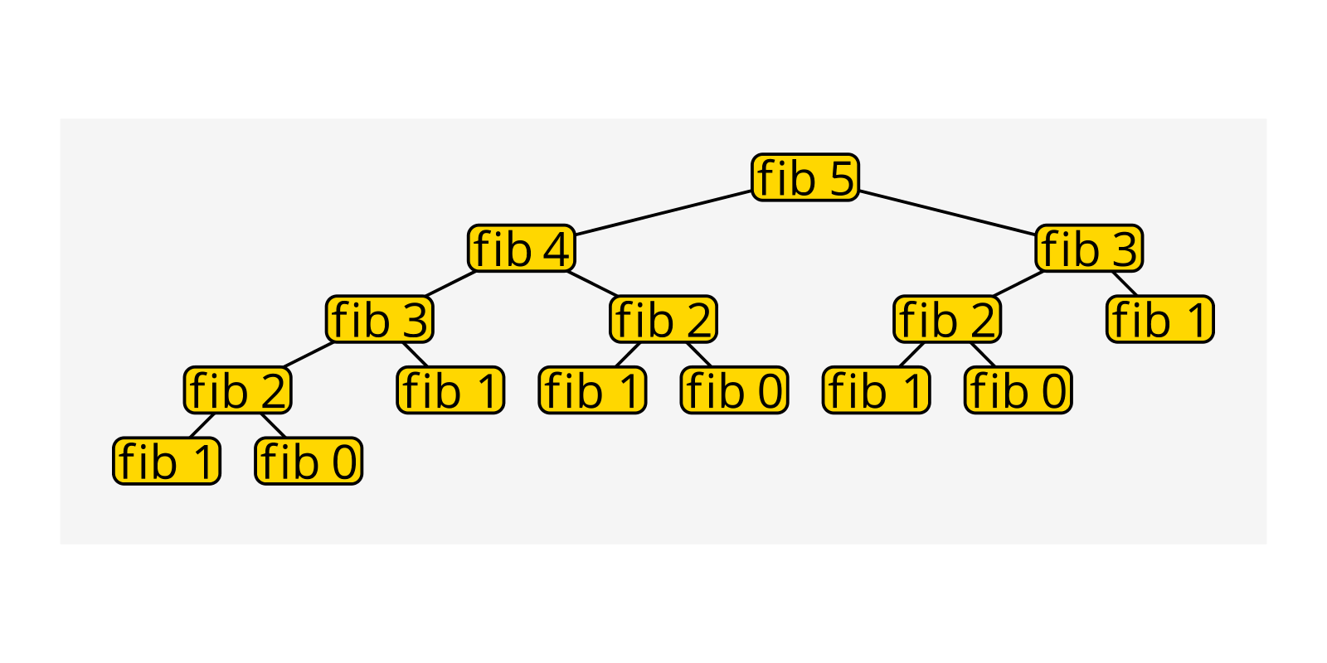

Slide 19
Recursive Fibonacci C implementation
#include <stdio.h>
// Recursive Fibonacci function
int fib_rec(int n) {
if (n == 0) return 0; // base case
if (n == 1) return 1; // base case
return fib_rec(n - 1) + fib_rec(n - 2); // recursive step
}
int main() {
int n = 6;
printf("Fibonacci(%d) using recursion = %d\n", n, fib_rec(n));
return 0;
}

Slide 20
Concept and Definition for (LO-2)
Time complexity and Space complexity.
Factorial (n!)
Iterative Approach
Algorithm: Use a loop from 1 to n, multiplying results.
Time Complexity:
O(n) (we perform n multiplications).
Space Complexity:
O(1) (only a few variables are used regardless of n).
Recursive Approach
Algorithm: fact(n) = n * fact(n-1), with base case fact(0)=1.
Time Complexity:
O(n) (one call per number until n reaches 0).
Space Complexity:
O(n) (because each recursive call is stored in the call stack until base case).
Conclusion (Factorial): Both iterative and recursive methods take O(n) time, but recursion uses O(n) space, while iteration is more space-efficient.

Slide 21
Time complexity and Space complexity.
Fibonacci (n-th term)
Iterative Approach
Algorithm: Start from Fib(0) and Fib(1), iteratively compute up to Fib(n).
Time Complexity:
O(n) (we compute each Fibonacci number once).
Space Complexity:
O(1) (only store the last two values at a time).
Naive Recursive Approach
Algorithm: fib(n) = fib(n-1) + fib(n-2) with base cases Fib(0)=0, Fib(1)=1.
Time Complexity:
O(2^n) (each call branches into two calls, massive repetition).
Space Complexity:
O(n) (maximum depth of recursion stack is n).

Slide 22
Recursive with Memoization (Dynamic Programming)
Algorithm: Store already computed Fibonacci values in an array or hash.
Time Complexity:
O(n) (each Fibonacci number computed only once).
Space Complexity:
O(n) (to store results + call stack).
Conclusion (Fibonacci):
Iterative is the most efficient: O(n) time and O(1) space.
Naive recursion is very inefficient: O(2^n) time, O(n) space.
Recursion with memoization improves time to O(n), but still uses O(n) space.

Slide 23
Final Comparison Table
Problem | Approach | Time Complexity | Space Complexity | Notes
Factorial | Iterative | O(n) | O(1) | Best for efficiency
Factorial | Recursive | O(n) | O(n) | Simple but higher space
Fibonacci | Iterative | O(n) | O(1) | Best option
Fibonacci | Recursive | O(2^n) | O(n) | Very inefficient
Fibonacci | Rec. + Memo | O(n) | O(n) | Good balance

Slide 24

Assessment: WooFlash Quiz

Slide 25
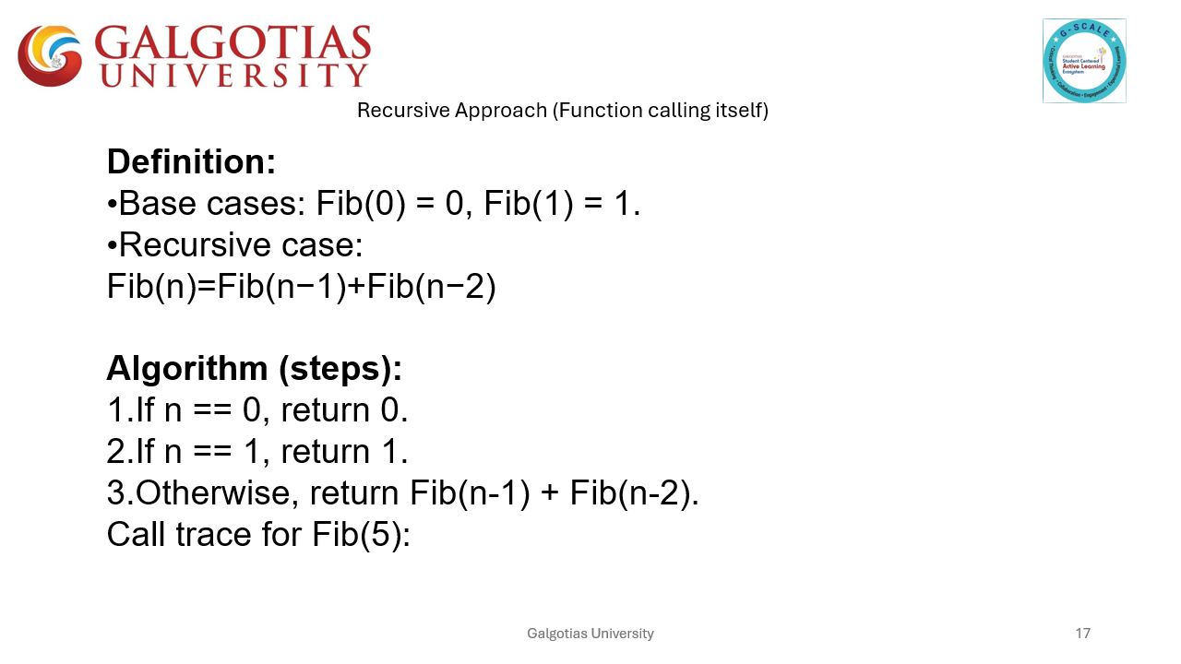
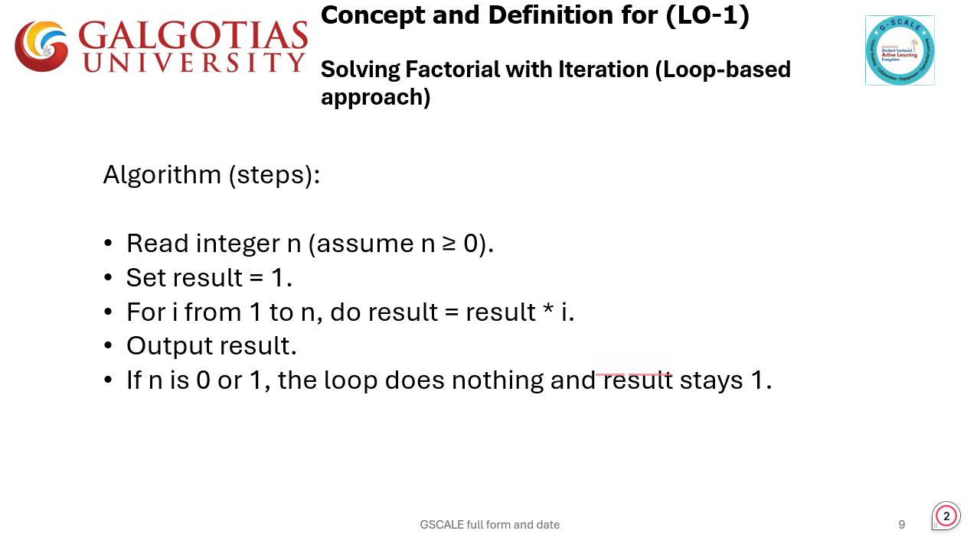
Summary
[1-mins]

Slide 26
[2-mins]
Ensure attainment of LO’s in alignment to the learning activities:
Apply iterative and recursive approaches to solve computational problems such as factorial and Fibonacci series.
Analyze and compare the efficiency of iteration and recursion in terms of time and space complexity for given problems.

Slide 27
[1-min]
Next Session:
Hanoi towers. Trade-offs between iteration and recursion.

Slide 28
Review and Reflection from students

